Slide 1
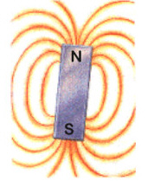
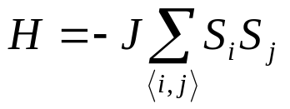
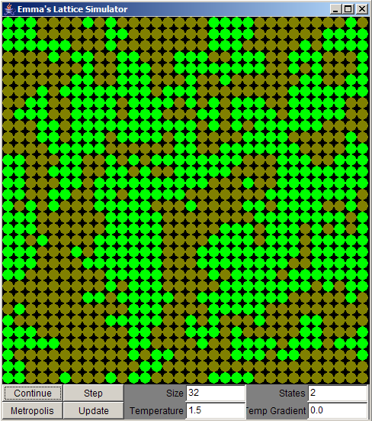
Potts Model Simulator
In 1925 it is was hypothesized that the electron has a ‘spin’ and so behaves like a tiny bar magnet.
Each spin interacts with its neighbours according to the Ising Hamiltonian:
e⁻
H = Energy of the system
J = Interaction Strength
S_{i}= Spin of Lattice site i
<i,j> = Sum over 4 nearest neighbours
Using this idea, Ising creating a model of magnetic material.
The Ising model treats each electron as a ‘spin’ on a regular lattice. Each spin can either be ↑ or ↓.
If two adjacent spins point in the same direction, their magnetic fields reinforce each other and increase the stability of the system.
For example, in a two spin system:
Spin ↑
electrons
↑↑ or ↓↓ : Spins parallel, H = -2J
↑↓ or ↓↑ : Spins anti-parallel, H = +2J
Spin ↓
electrons

Slide 2
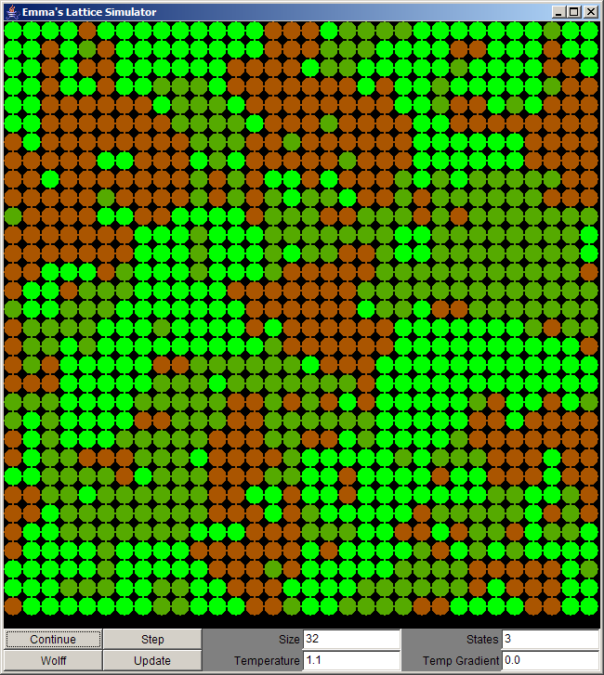
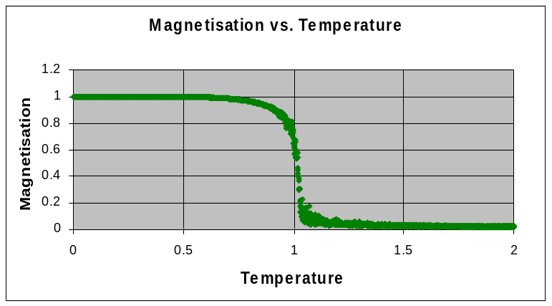
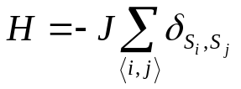
The q-state Potts Model is an extension of the Ising model, allowing the spins to take any value from 1,…,q.
The program simulates thermal fluctuations using a ‘Dynamic Algorithm’, changing individual spins or clusters of spins at a time.
In the low temperature regime, the spins tend to align to produce an overall magnetisation. At some specific temperature, the thermal fluctuations become stronger than the spin interactions, and the system tends to a paramagnetic state.
Spin=1 site
Spin=2 site
Spin=3 site
This is a graphical interpretation of the 3 state Potts Model in the High Temperature Regime
The interactions in the Potts model are defined by it’s Hamiltonian:
Analytically solving the Ising model to find this Critical Temperature was a major breakthrough in Statistical Physics.
The Krőnecker delta represents the spin interaction, reducing the energy if neighbouring spins are equal.
Verifying the theoretical results using the program is the aim of this project.
A Java implementation of the q-state Potts model was written to study its properties.

Slide 3
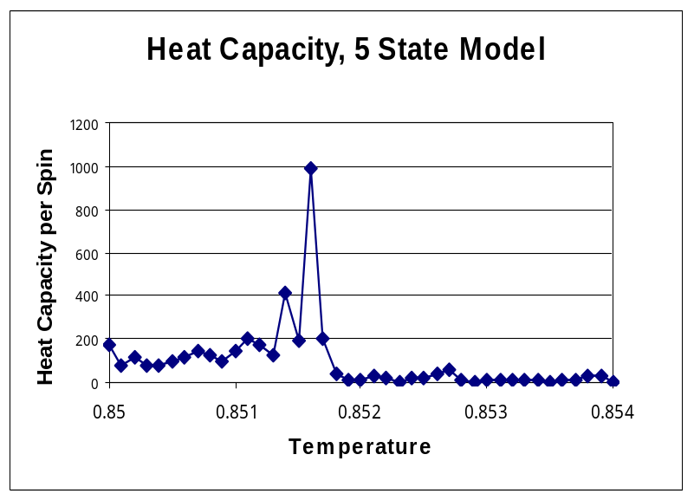
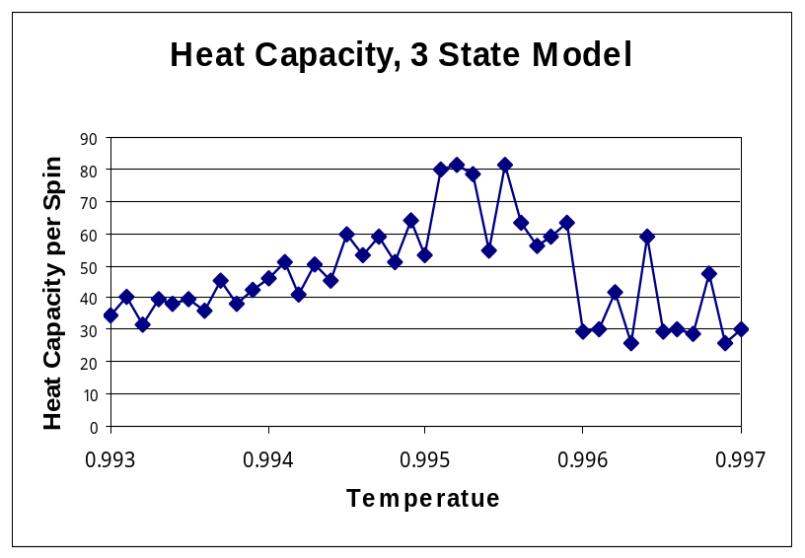
Theory Predicts that the 3 state model has a second order phase transition and the 5 state model has a first order phase transition at the Critical Temperature.
By measuring the Heat Capacity of the system, the order of the transition becomes apparent.
Critical Temperature
At a first order phase transition, the Heat Capacity shows a discontinuity at the critical temperature.
Critical Temperature
The results obtained from the program agree with the theory for the critical temperatures and the nature of the phase transitions.
At a second order phase transition, the Heat Capacity is continuous, and changes smoothly at the critical temperature.

Slide 4
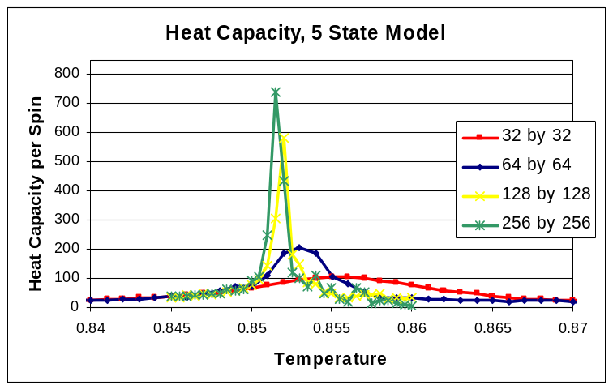
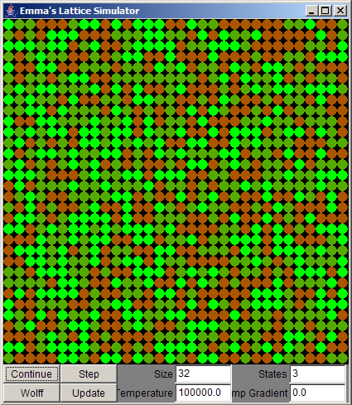
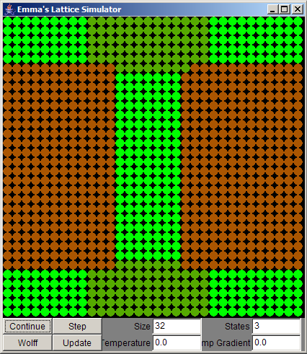
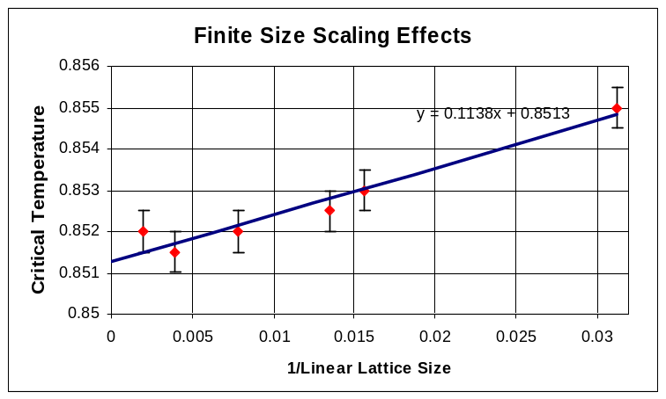
As the size of the lattice changes, the temperature of the phase transition changes. An effect called Finite Size Scaling.
In conclusion, the results obtained from this project confirm the theoretical results to within the error bounds
A possible future extension of the project is investigate the stable clusters that form if the lattice is cooled very quickly from T=∞ to T=0
The critical temperature for an infinite lattice was calculated by plotting the inverse size against the critical temperature of the finite lattices.

